Slide 1

ENGINEERING CHEMISTRY
Asha A
Department of Science and Humanities

Slide 2

ENGINEERING CHEMISTRY
Module I- Molecular Spectroscopy
Class content:
Expression for rotational energy levels of a diatomic molecule
Selection rules
Rotational spectrum

Slide 3
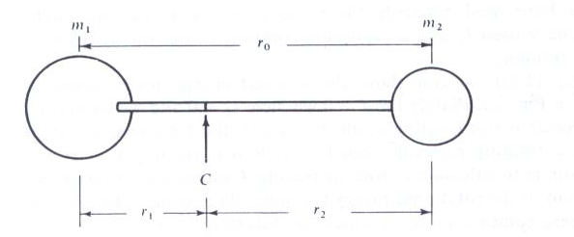
Derivation of Moment of Inertia for a heteronuclear diatomic molecule- rigid rotor model
ENGINEERING CHEMISTRY
Module I- Molecular Spectroscopy
Expressions for rotational energy levels for a diatomic molecule
Source:Fundamentals of Molecular Spectroscopy: C. N. Banwell and Elaine M McCash, Fifth Edition, MCGRAW-HILL Education (India) Private Ltd.
A rigid diatomic molecule with masses m₁ and m₂ joined by a thin rod of length r ₀ = r₁ + r₂ .The centre of mass is at C

Slide 4
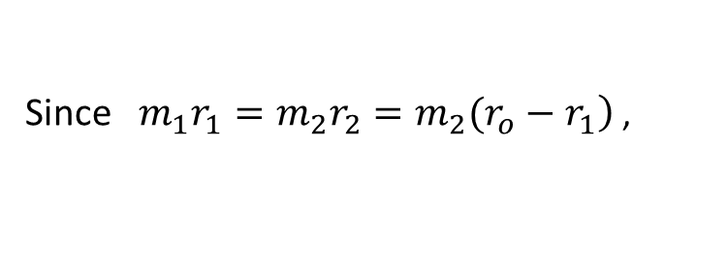
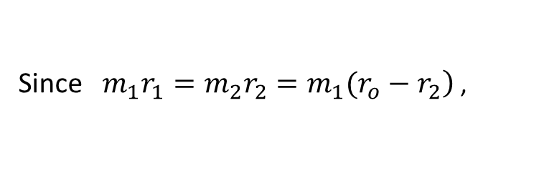
ENGINEERING CHEMISTRY
Module I- Molecular Spectroscopy
The molecule rotates end- over- end about a point C, the centre of gravity ,
this is defined by the moment, or balancing, equation:
The moment of inertia about C is defined by
I = m₁r₁² + m₂r₂²
Since $\left.m_{1}r_{1}=m_{2}r_{2}=m_{2}(r_{o}−r_{1}\right)$ ,
Since $\left.m_{1}r_{1}=m_{2}r_{2}=m_{1}(r_{o}−r_{2}\right)$ ,
Therefore
Where μ is the reduced mass given by

Slide 6
ENGINEERING CHEMISTRY
Module I- Molecular Spectroscopy
The quantity J , rotational quantum number, which can take integral values from zero upwards; J=0,1,2,3...... Hence the rotational energy levels are quantised and given by the expression,
h= Planck’s constant=6.626×10⁻³⁴ Js and I is the moment of inertia

Slide 7

ENGINEERING CHEMISTRY
Module I- Molecular Spectroscopy
The energy expressed in spectroscopic units(cm⁻¹) is given by :
which can be written as
where
B is known as the rotational constant
Substituting for values of
J = 0,1,2,3..., we can get the energies for the rotational levels
J | ε_{J}
0 | 0
1 | 2B
2 | 6B
3 | 12B
Source:Fundamentals of Molecular Spectroscopy: C. N. Banwell and Elaine M McCash, Fifth Edition, MCGRAW-HILL Education (India) Private Ltd.

Slide 9
ENGINEERING CHEMISTRY
Module I- Molecular Spectroscopy
The selection rules for rigid rotor model obtained after solving Schrodinger equation is :
Gross selection rule – molecule should possess permanent dipole moment
Δ J = ± 1
Since
For rotational transition of a molecule from level J → J +1 , the energy absorbed is given by
Substituting for values for J = 0,1,2,3....
J | Δε_{(J→J+1)}
0 | 2B cm⁻¹
1 | 4B cm⁻¹
2 | 6B cm⁻¹

Slide 10
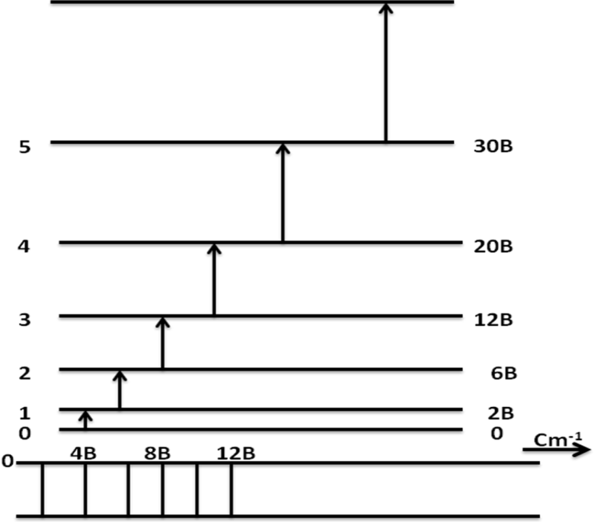
Rotational energy levels and spectrum
ENGINEERING CHEMISTRY
Module I- Molecular Spectroscopy
J | Δε_{(J→J+1)}
0 | 2B cm⁻¹
1 | 4B cm⁻¹
2 | 6B cm⁻¹
3 | 8B cm⁻¹
4 | 10B cm⁻¹
Source:Fundamentals of Molecular Spectroscopy: C. N. Banwell and Elaine M McCash, Fifth Edition, MCGRAW-HILL Education (India) Private Ltd.

Slide 11
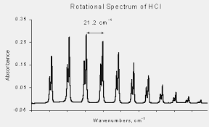

Information obtained from the rotational spectrum
ENGINEERING CHEMISTRY
Module I- Molecular Spectroscopy
Source:http://www.physics.dcu.ie/~be/Ps415/Rotational1.pdf
The first line in the spectrum appears at 2B cm⁻¹ and the distance between any two consecutive lines is constant and is equal to 2B cm⁻¹ . We can get value of ‘B’ from the spectrum and calculate ,I, the moment of inertia using the expression
Since I = µ r_{o}² , r_{o} can be determined ;
r_{o} is the bond length of the molecule
The spectrum also reveals that some higher rotational levels are also populated at room temperature

Slide 12
ENGINEERING CHEMISTRY
Module 1- Molecular Spectroscopy
1. Calculate the rotational constant for an NO molecule. Given atomic masses of N and O are 14.004 amu and 15.9994 amu respectively. The bond length of NO is 115 pm.
(1 amu = 1.66 x 10⁻²⁷ kg, c = 3 x 10⁸ ms⁻¹, h=6.6x 10⁻³⁴ Js)
Solution:

Slide 13
THANK YOU
Asha A
Department of Science and Humanities

